Slide 1
sup3rS1ckt3m1337
Voogasalad Presentation
04/13/2017
Genre : Tower Defense

Slide 2
Project Restructuring
Game Authoring Environment
Game Engine
Game Player
Game Data
Front End
Engine
Environment
Banks
Data
State

Slide 3
Application High Level Design
BackEnd
Controller
FrontEnd
DataController
(XML Stuff)
Model
View
GameData
Mode
Engine
Bank
Modification Channel
- State
- Rules
- Status
- Author
- Player
- Engines
- Behaviors
- Tiles
- Components
- Attributes
- Rules
- Behaviors
Skeleton
Menus
- Canvas
- Sidebar
- Creation Palette
- Splash Screens
- Settings
- Saving / Loading

Slide 4

Subteam: Front End (Game Player)

Slide 5
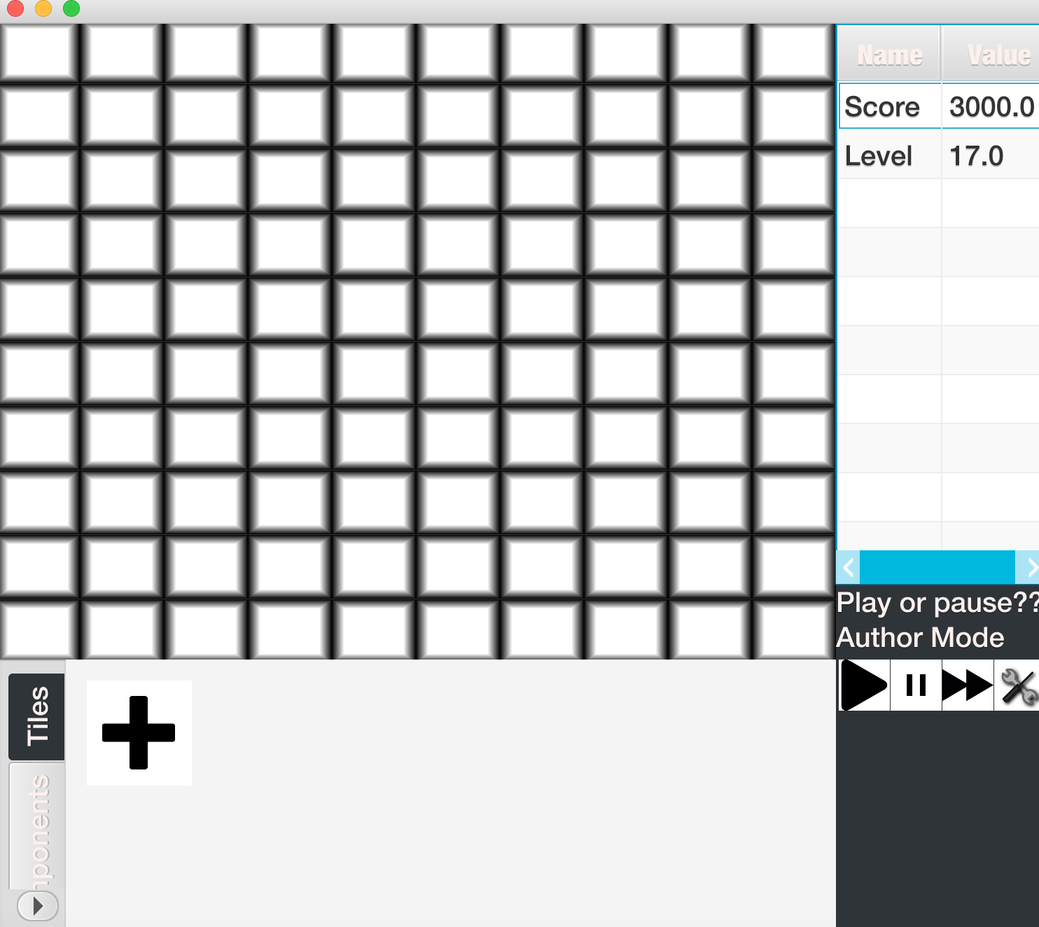
High Level Design
MainMenu
GameMaker
GameLoader
View
Skeleton
Canvas
FrontEndAttributeOwner
CommandCenter
User Tools
SideBar
StatusView
BottomRoot
Palette
Open/Closed
MainMenu
Add option, never know what it does
Skeleton
Can add features to Canvas/UserTools
UserTools can be/do anything
Canvas
Can add any FrontEndAttributeOwner
Can represent anything (enemy, tower, etc)
Any CommandCenter can be launched
Changing of components → invokable call

Slide 6
Big TradeOffs
Observers Versus Bindings
Many ways to start a game
Loading saved game
Creating new game
Starting a template game
Reflection versus New Class

Slide 7


Extensions/Plans for Future
Improving Animation
UX
Social Media Center
Avatar, Messages with other players
Database or connection to internet
I

Slide 8
Subteam: Engine Team
Design Overview
Each main type of behavior controlled by a specific engine
i.e. MoveEngine controls all Component movement
GameProcessController owns an instance of all Engines
Each iteration of the game loop:
GameProcessController calls run() on each Engine once
Each Engine runs on each Component once
Engines create a Behavior for each Component
These Behaviors modify Attributes
Behaviors
Main Loop
Move
Attack
Death
Spawn

Slide 9
Subteam: Engine Team
Components
Attributes
Attributes are the fields in Components that are responsible for all data/state storage
Attributes modified by Engines through Behaviors
Behavior
Behaviors are created by Engines for each Component
Behaviors modify their corresponding Attribute based on Engine’s instructions

Slide 10




Subteam: Engine Team
Engines
Move Engine
Responsible for moving all Components based on BFS pathfinding algorithm
Attack Engine
Responsible for firing projectiles from towers at targets
Death Engine
Responsible for checking death conditions and removing Components from State
Spawn Engine
Reads in Enemy spawn order and locations and spawns them

Slide 11
Subteam: Engine Team Design Tradeoffs
Major Issues:
Where to hold Engines
Embed in Authoring Environment to allow for modification in the middle of gameplay
Whether to use Behaviors
Decided to do so to limit data passing - Behaviors only need the Component, not the entire State
But extra step in modifying object from engine: engine needs to call behavior, can’t access attributes directly. Encapsulation vs. using lots of setters.
Attributes
Used as generics- easily extendable but need to cast

Slide 12
Subteam: Environment
Banks
Need something to load and save Preset components and tiles that the Author makes
State
Holds the state information for the Components (towers, sprites, etc.) and the Tiles (grid locations/terrain)
Data Controller
Loads and saves both GameStateData and UniversalGameData
ModificationFromUser
Invokables used by the Front-End when the user interacts with the State or Rule
Front-End-Back-End Integration
Fulfill the “empty data-paths” that fully connect the program

Slide 13
Subteam: Environment
State
ComponentGraph
Component
TileGrid
Tile
Bank Controller
TileBank
ComponentBank
Data
DataController
XMLReader
XMLWriter
ModificationFromUser
Modification_EditAttribute
Modification_Save
...

Slide 14
Subteam: Environment
Front-End-Back-End Integration
Successful Passing/Interpreting of Attributes
Load GameState from XML into Game Environment
Front-End Modification Channel
Front-End Maintaining Unmodifiable State Objects (ID’s)
Soft vs. Hard Cloning of Preset Attributes/Components
Node Graph vs. 2D Array for State
AccessPermissions (Components/Tiles in User/Game Modes)
Mode Object
Notes:
ModificationFromUser interface
Front-end recognizes a user interaction that modifies the back end
Front end does not have direct access to the model (back end)
Instantiates appropriate ModificationFromUser invokable
Sends invokable to controller
Gives the invokable access it needs to modify the back end
ModificationFromUser checks the mode (author or player)
Execute user modification for appropriate mode without front end knowing the mode

